Slide 1

Digital Design and Verification Training
System Verilog 2

Slide 2
Agenda

Slide 3
Modeling Communication Buses — Interface Ports
Designs often use standard bus protocols such as PCI Express, USB, or AMBA AXI.
Bus protocols bundle together several signals, including data signals, address signals, and various control signals.
Interface - an interface port bundles related signals together as a single, compound port.
Notes:
In RTL, procedural blocks executed in one cycle while Behavioral level takes multiple cycles.
Behavioral level uses full sys verilog with no restrictions while there are in RTL

Slide 4
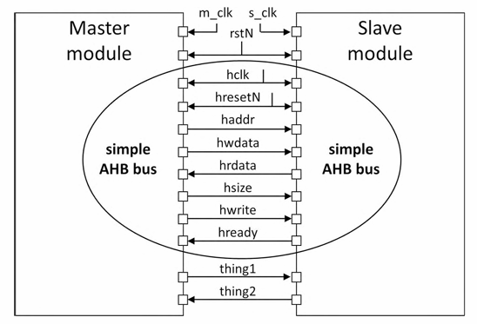
Modeling Communication Buses — Interface Ports
AMBA AHB bus
Notes:
In RTL, procedural blocks executed in one cycle while Behavioral level takes multiple cycles.
Behavioral level uses full sys verilog with no restrictions while there are in RTL

Slide 5
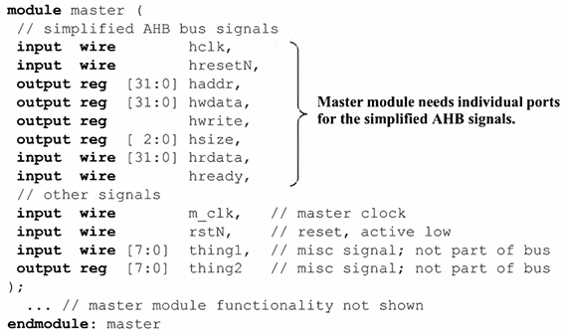
Modeling Communication Buses — Interface Ports
Notes:
In RTL, procedural blocks executed in one cycle while Behavioral level takes multiple cycles.
Behavioral level uses full sys verilog with no restrictions while there are in RTL

Slide 6
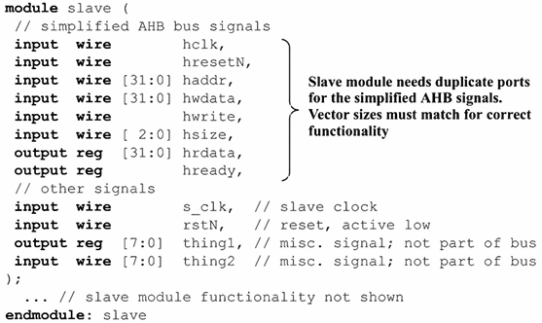
Modeling Communication Buses — Interface Ports
Notes:
In RTL, procedural blocks executed in one cycle while Behavioral level takes multiple cycles.
Behavioral level uses full sys verilog with no restrictions while there are in RTL

Slide 7
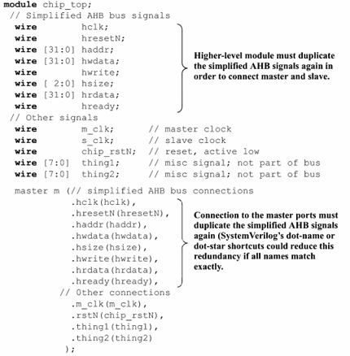
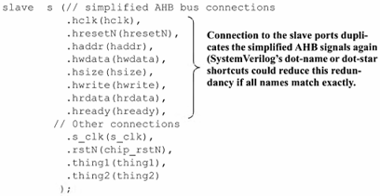
Modeling Communication Buses — Interface Ports
Notes:
In RTL, procedural blocks executed in one cycle while Behavioral level takes multiple cycles.
Behavioral level uses full sys verilog with no restrictions while there are in RTL

Slide 8
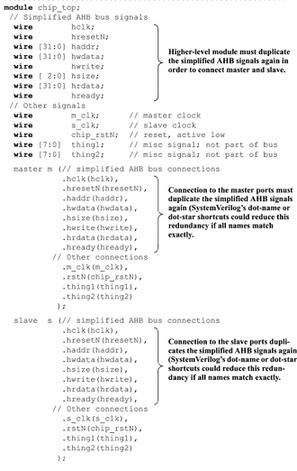
Modeling Communication Buses — Interface Ports
Notes:
hclk -> Hclk : 5 places to go and modify!

Slide 9
Modeling Communication Buses — Interface Ports
Notes:
hclk -> Hclk : 5 places to go and modify!

Slide 10
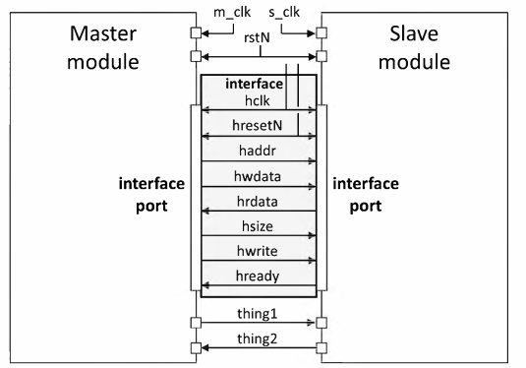
Modeling Communication Buses — Interface Ports
Notes:
hclk -> Hclk : 5 places to go and modify!

Slide 11
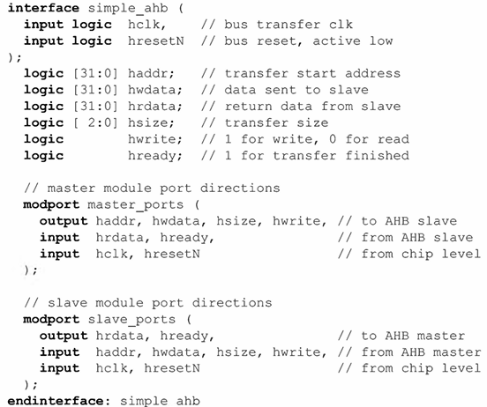
Modeling Communication Buses — Interface Ports
Notes:
hclk -> Hclk : 5 places to go and modify!

Slide 12
Modeling Communication Buses — Interface Ports
Notes:
hclk -> Hclk : 5 places to go and modify!

Slide 13
Modeling Communication Buses — Interface Ports
Notes:
hclk -> Hclk : 5 places to go and modify!

Slide 14
Modeling Communication Buses — Interface Ports
Notes:
hclk -> Hclk : 5 places to go and modify!

Slide 15
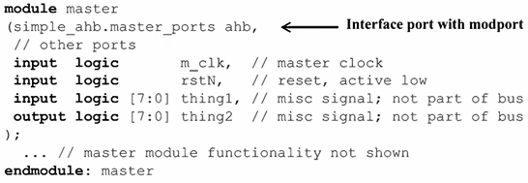
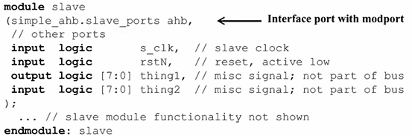
Modeling Communication Buses — Interface Ports
Notes:
hclk -> Hclk : 5 places to go and modify!

Slide 16
Modeling Communication Buses — Interface Ports
Notes:
hclk -> Hclk : 5 places to go and modify!

Slide 17
Modeling Communication Buses — Interface Ports
Notes:
hclk -> Hclk : 5 places to go and modify!

Slide 18
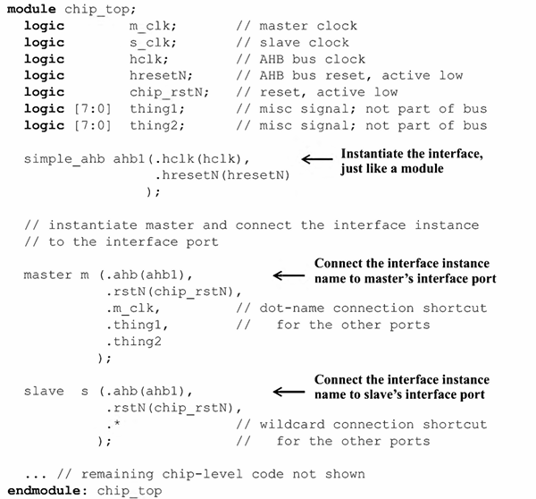
Modeling Communication Buses — Interface Ports
Notes:
hclk -> Hclk : 5 places to go and modify!

Slide 19
Modeling Communication Buses — Interface Ports
Notes:
hclk -> Hclk : 5 places to go and modify!

Slide 20
Modeling Communication Buses — Interface Ports
Notes:
hclk -> Hclk : 5 places to go and modify!

Slide 21
Modeling Communication Buses — Interface Ports
Notes:
hclk -> Hclk : 5 places to go and modify!

Slide 22
Modeling Communication Buses — Interface Ports
Notes:
hclk -> Hclk : 5 places to go and modify!

Slide 23
Modeling Communication Buses — Interface Ports
Notes:
hclk -> Hclk : 5 places to go and modify!

Slide 24
Modeling Communication Buses — Interface Ports
Notes:
hclk -> Hclk : 5 places to go and modify!

Slide 25
Modeling Communication Buses — Interface Ports
Notes:
hclk -> Hclk : 5 places to go and modify!

Slide 26
Modeling Communication Buses — Interface Ports
Notes:
hclk -> Hclk : 5 places to go and modify!

Slide 27

Modeling Communication Buses — Interface Ports
Referencing signals within an interface – Inside the master module
Notes:
hclk -> Hclk : 5 places to go and modify!

Slide 28
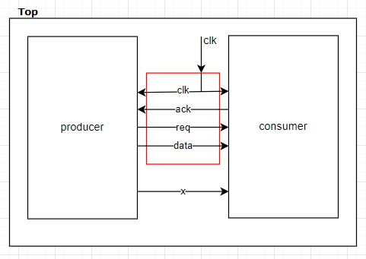
Modeling Communication Buses — Interface Ports
Write system Verilog code for the design shown below. There is an interface (red box). The function of producer is to
send 8-bit data and 1-bit req on posedge of the clk. The function of the consumer is to set 1-bit ack = 1 when req = 1
otherwise set ack = 0. The clk must be created and attached in the top module.
Notes:
hclk -> Hclk : 5 places to go and modify!

Slide 29
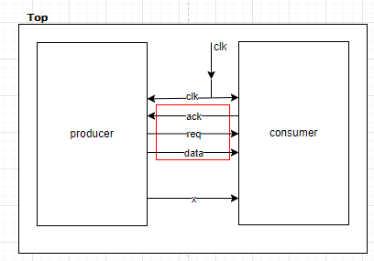
Modeling Communication Buses — Interface Ports
Write system Verilog code for the design shown below. There is an interface (red box). The function of producer is to
send 8-bit data and 1-bit req on posedge of the clk. The function of the consumer is to set 1-bit ack = 1 when req = 1
otherwise set ack = 0. The clk must be created and attached in the top module.
Notes:
hclk -> Hclk : 5 places to go and modify!

Slide 30

Modeling Sequential Logic
Use the SystemVerilog always_ff RTL-specific procedure to model RTL sequential logic.
Procedure sensitivity list must specify clk edge.
The sensitivity list must specify the leading edge (p osedge or negedge) of any asynchronous set or reset signals.
Other than the clock, asynchronous set or asynchronous reset, the sensitivity list cannot contain any other signals, such as the D input or an enable input.
Only use nonblocking assignments (<=) to assign the output variables of sequential logic blocks.
A variable assigned a value in a sequential logic procedure cannot have a mix of blocking and nonblocking assignments. For example, the reset branch cannot be modeled with a blocking assignment and the clocked branch modeled with a non- blocking assignment.
Notes:
hclk -> Hclk : 5 places to go and modify!

Slide 31
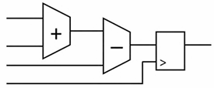

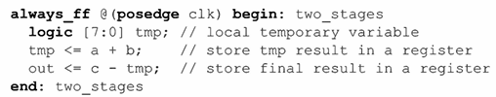
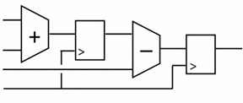
Modeling Sequential Logic
Temporary Variables
Temporary variables assigned with a blocking assignment and used within a sequential logic always procedure cannot be used outside of the procedure.
Notes:
always_comb begin
tmp = a + b;
out_next = c - tmp;
end
// Sequential logic: register the final result
always_ff @(posedge clk) begin
out <= out_next;
End
2 cycles to get out in 2nd example

Slide 32



Modeling Sequential Logic
Synchronous/Asynchronous resets and chip enable
Notes:
hclk -> Hclk : 5 places to go and modify!

Slide 33
User Defined Types
var logic unsigned [3:0] a;
typedef logic unsigned [3:0] nibble;
var nibble a;
Notes:
hclk -> Hclk : 5 places to go and modify!

Slide 34
User Defined Types
enum {RED, BLUE, GREEN} rgb;
enum logic [2:0] {RED = 3’b011,
GREEN = 3’b101,
BLUE = 3’b110} rgb;
Notes:
hclk -> Hclk : 5 places to go and modify!

Slide 35
User Defined Types
enum logic [2:0] {RED = 3’b011,
GREEN = 3’b101, BLUE = 3’b110} a;
enum logic [2:0] {RED = 3’b011,
GREEN = 3’b101, BLUE = 3’b110} b;
my a;
my b;
my c;
typedef enum logic [2:0] {RED = 3’b011,
GREEN = 3’b101
BLUE = 3’b110} my;
enum logic [2:0] {RED = 3’b011,
GREEN = 3’b101, BLUE = 3’b110} c;
Notes:
hclk -> Hclk : 5 places to go and modify!

Slide 36
Modeling Sequential Logic
Modeling Finite State Machines (FSMs)
Model FSMs in a separate module.
Use enumerated variables for FSM state variables.
For most Finite State Machines, use a three-process coding style
Notes:
hclk -> Hclk : 5 places to go and modify!

Slide 37
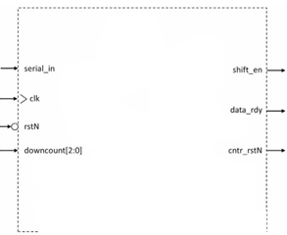



Modeling Sequential Logic
Modeling Finite State Machines (FSMs)
Notes:
hclk -> Hclk : 5 places to go and modify!

Slide 38
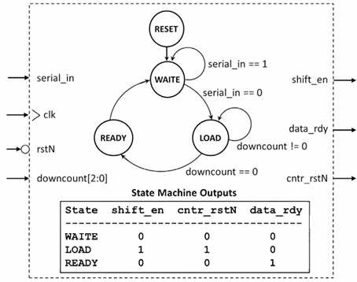
Modeling Sequential Logic
Modeling Finite State Machines (FSMs)
Notes:
hclk -> Hclk : 5 places to go and modify!

Slide 39
Modeling Sequential Logic
Modeling Finite State Machines (FSMs)
Notes:
hclk -> Hclk : 5 places to go and modify!

Slide 40
Modeling Sequential Logic
Modeling Finite State Machines (FSMs)
Notes:
hclk -> Hclk : 5 places to go and modify!

Slide 41
Modeling Sequential Logic
Modeling Finite State Machines (FSMs)
Notes:
hclk -> Hclk : 5 places to go and modify!

Slide 42
Modeling Sequential Logic
Modeling Finite State Machines (FSMs)
Notes:
hclk -> Hclk : 5 places to go and modify!

Slide 43
Modeling Sequential Logic
Modeling Finite State Machines (FSMs)
Notes:
hclk -> Hclk : 5 places to go and modify!

Slide 44
Modeling Sequential Logic
Modeling Finite State Machines (FSMs)
Notes:
hclk -> Hclk : 5 places to go and modify!

Slide 45
Modeling Sequential Logic
Modeling Finite State Machines (FSMs)
Notes:
hclk -> Hclk : 5 places to go and modify!

Slide 46
Modeling Sequential Logic
Modeling Finite State Machines (FSMs)
Notes:
hclk -> Hclk : 5 places to go and modify!

Slide 47
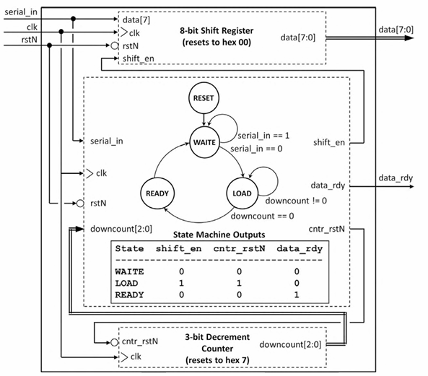
Modeling Sequential Logic
Notes:
hclk -> Hclk : 5 places to go and modify!

Slide 48
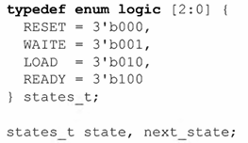

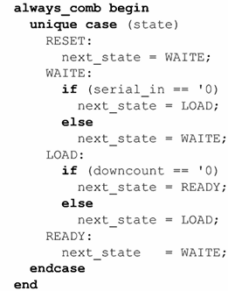
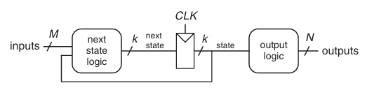
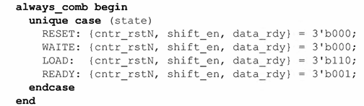
Modeling Sequential Logic
Notes:
hclk -> Hclk : 5 places to go and modify!

